Slide 1

UTS MARKETPLACE
UTS ENGSOC x FEIT Hackathon 2021

Slide 2
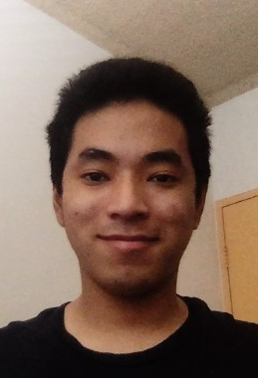
Team Members
Sanskar Gauchan
2nd year BSCIT
I can do a burnout on a motorbike

Slide 3
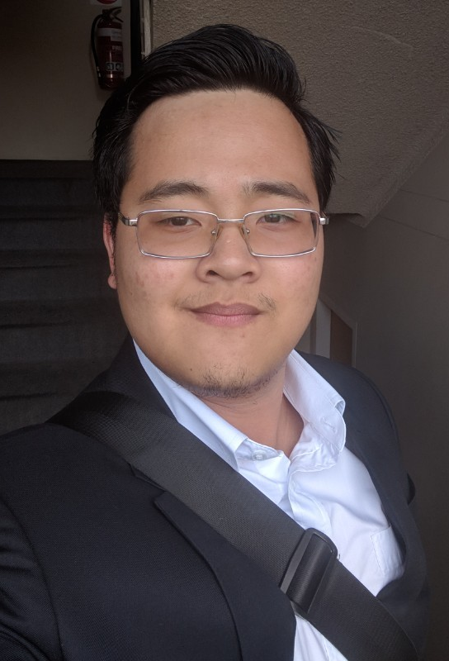
Team Members
Minh Hoang Nguyen
Final year Electrical Engineering students
I can do a cool hand wave

Slide 4
Why 2 members?
Because the others left us! We are too cool for them!

Slide 5
The Idea
A centralised and an internal website for UTS Campus students to buy and sell their belongings when not used. Be it that for upgrading or moving out, the students can put up their item on sale and our team will arrange a meeting day to come and inspect the item. If the representative determine that the item is still usable and in relatively good condition, they will approve the item to be put display on the marketplace.
After the item is put up for sale, the buyer can contact the seller directly without contacting the team. The seller can adjust the price and the buyer has the ability to negotiate the price.
In any cases that the item is not sellable, the students have the option to let the inspector to take that item for recycle purposes. The team will collect all unusuable product and recycle them according to the local Sydney council.

Slide 6
How is the idea in line with the scope of the hackathon?
If more items are being reused and recycled, the less waste is produced.

Slide 7
Target
All UTS students living on campus and all students living in the Central Sydney area. To access the website, students are required to registered with there UTS email account.

Slide 8

Demo

Slide 9

Questions?

